Slide 1
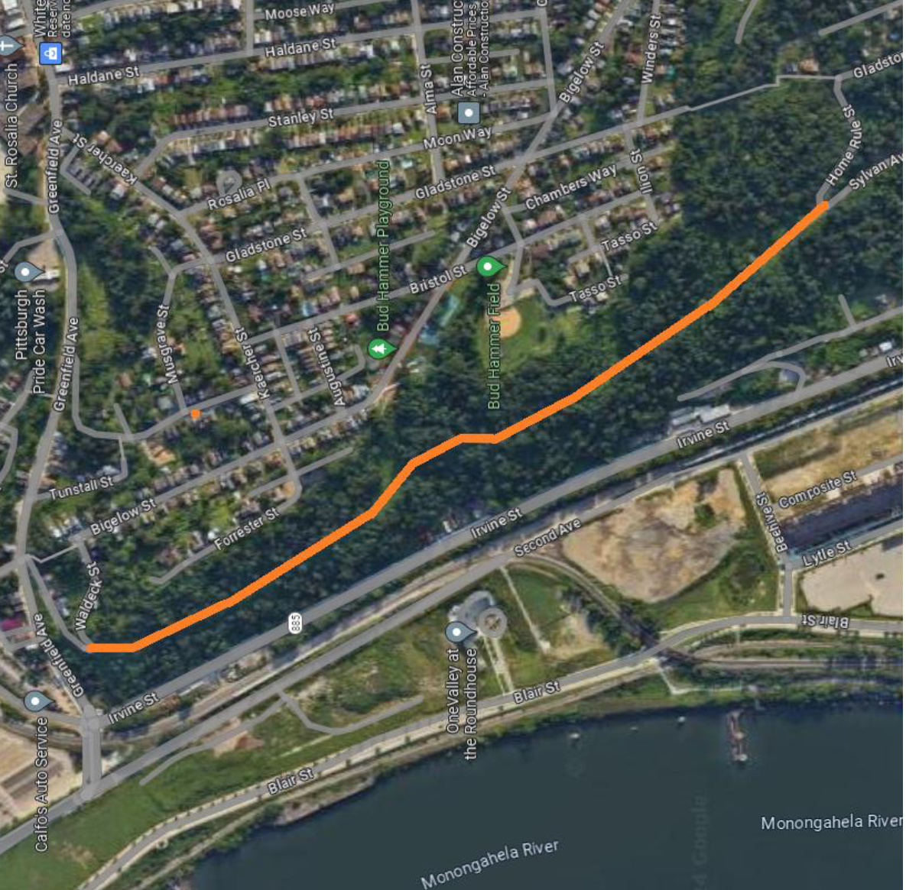
Welcome
Sylvan Avenue Trail
Community
Meeting

Slide 2
Agenda
Introduction/How we got here
Our questions and concerns:
Community input
Environmental/Safety
Budget/Transparency
Project scope (past and present)
Q&A – What is your vision for the trail?

Slide 3
Building a true community asset takes time
and ground-level community involvement.
Pennsylvania Trail Design & Development Principles: Guidelines for Sustainable, Non-Motorized Trails https://cdn2.assets-servd.host/material-civet/production/images/documents/Pennsylvania_Trail_Design_and_Development_Principles.pdf?dm=1633032428
How we got here

Slide 4
Building a true community asset takes time
and ground-level community involvement.
https://engage.pittsburghpa.gov/sylvan-avenue-trail

Slide 5
Community
Who exactly is this proposed trail intended to serve?
What comprehensive survey shows that Hazelwood and Greenfield residents have an overwhelming need to travel to Oakland in particular?
What residents of Hazelwood and/or Greenfield were involved in the proposed design of this project?

Slide 6
Community documents referenced
https://actionnetwork.org/petitions/our-money-our-solutions
Update needed to remove the Mon-Oakland Connector?
https://apps.pittsburghpa.gov/redtail/images/7601_Final_Hazelwood_Plan.pdf
“Develop without displacement”

Slide 7
Community
Which community organizations and residents of affected areas were involved in deciding this trail was a need before DOMI sought grant funding?
Acknowledged the background of this project (Mon-Oakland Connector—community input not sought before grant application)
Assured everyone that the MOC is dead, defunded
To assuage concerns about a future buildout of “phase 2” of MOC, pointed to ordinance passed related to development in public parks
Hazelwood greenway is in the process of being designated a city park (will seek the same designation for the Elizabeth Street portion)

Slide 8
Community
Why concerns about “phase 2” of MOC?
https://www.junctioncoalition.org/wp-content/uploads/2020/01/1-7-20_Mon-Oakland-memo.pdf

Slide 9
Community
Have there been any zoning variances issued for this project? Did City Council and/or the zoning board grant approval for the variance(s), and were any terms or conditions attached to the approval(s) and was it communicated to the community and the public at large if a zoning variance was granted?
Were the Sylvan Avenue Trail and/or any surrounding parcels re-zoned for research and development? If so, does that conflict with the greenway designation?
No rezoning has occurred or is proposed.

Slide 10
Environmental/Safety
According to the PA Trail Design and Development Principles document (that the City of Pittsburgh is required to follow), water is the No. 1 cause of trail failure. With multiple springs in the area, what is the long-term plan for water mitigation?

Slide 11
Environmental/Safety
What active or passive stormwater treatment will you be seeking for the trail?
What is the plan for moving water so it’s not eroding the trail? The landslide risk of culverting the water (more from uphill to downhill on unstable slopes) could be dangerous. If the plan is to use pipes to move water away from the project site, how would you offset the issue of flooding in the surrounding neighborhoods?
Who is responsible for/Who regulates the undocumented/unregulated dam uphill from the project area? What is the human health risk and trail risk of dam failure? What will happen to houses on the downhill side of the trail project?
To what extent would the City of Pittsburgh be liable if the dam fails or another landslide occurs during or after construction of the Sylvan Avenue Trail project?
What plans are in place to prevent mine drainage from the mine near the project area?
What steps have been taken to ensure that construction in the project area will not cause another landslide?
What is the plan to mitigate risks associated with the mine as a result of moving earth for this project?

Slide 12
Environmental/Safety
The 11/5/21 grant application states, “Various agencies, such as the water and sewer authority, will need to be approached for approval.” Has the city approached these agencies for approval, and if so was it before or after the MOC project was canceled by Mayor Ed Gainey?
Will you provide for independent review engineering and construction documents including but not limited to schematics and blueprints, core sample results, line and grade documents, preliminary and final construction drawings, signed and sealed drawings, and project summary documents?

Slide 13
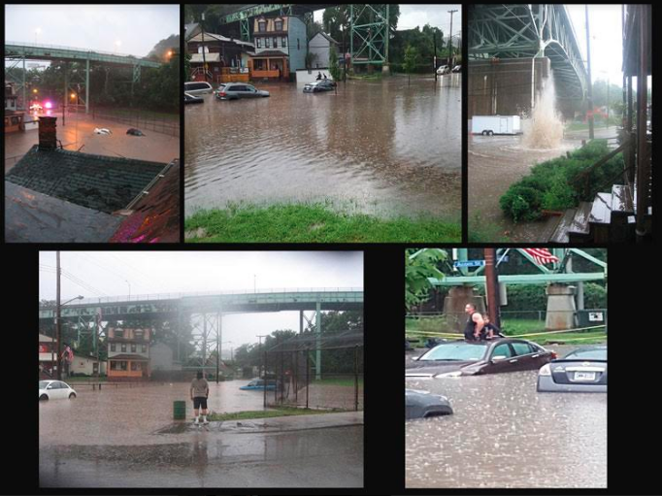
Environmental/Safety
“Water will be conveyed to existing storm systems”
“PWSA maintains a facility in the area; water mitigation will tie into their facility”

Slide 14
Other environmental risks

Slide 15
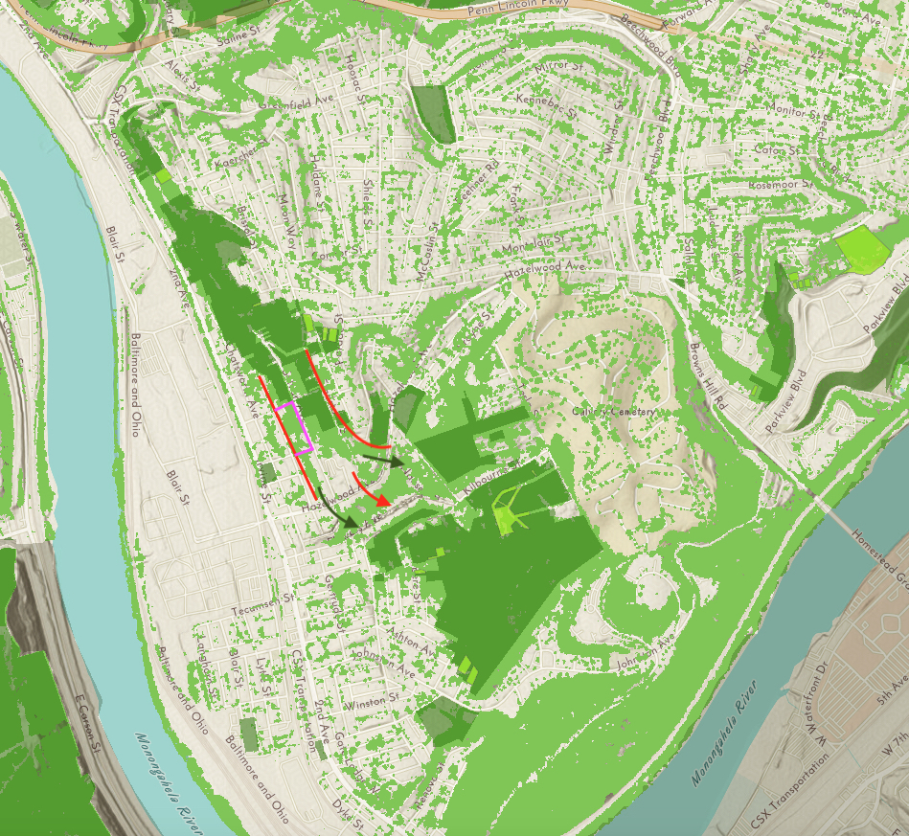
Notes:
Sylvan Avenue was closed several decades ago (1960s?) due to mine subsidence and other issues. Since then this corridor has become a critical biological link, connecting Hazelwood's core Greenway forests, some 180+ acres adjacent to the Calvary Cemetery, with Schenley Park. Much of the Sylvan Avenue corridor is designated Greenway, and there is significant amount of unprotected canopy forest owned by the City that could be vulnerable to urban development. See jpeg, attached, Line Map. The dark green areas indicate Greenway, the light green is the Canopy Forest as identified by Tree Pittsburgh. (the orange circle is the site of a proposed development, the Woods Village housing proposal, a separate but related controversy).
Of concern here is the proposal from DOMI to open the Sylvan Avenue corridor from Home Rule Street to Greenfield Avenue, as a "trail" that looks suspiciously like a road. Their proposal would pave six tenths of a mile with impervious pavement, traditional toxic asphalt appears to be their preferred choice. Their proposal also includes streetlight type lighting, despite the fact that Parks close at dusk! There is no other trail with night-lights in our city's Park system to my knowledge. When asked why this is proposed they compared this remote, unused trail with places like sports arenas, and "fear of the dark" as justification for this anomaly.

Slide 16
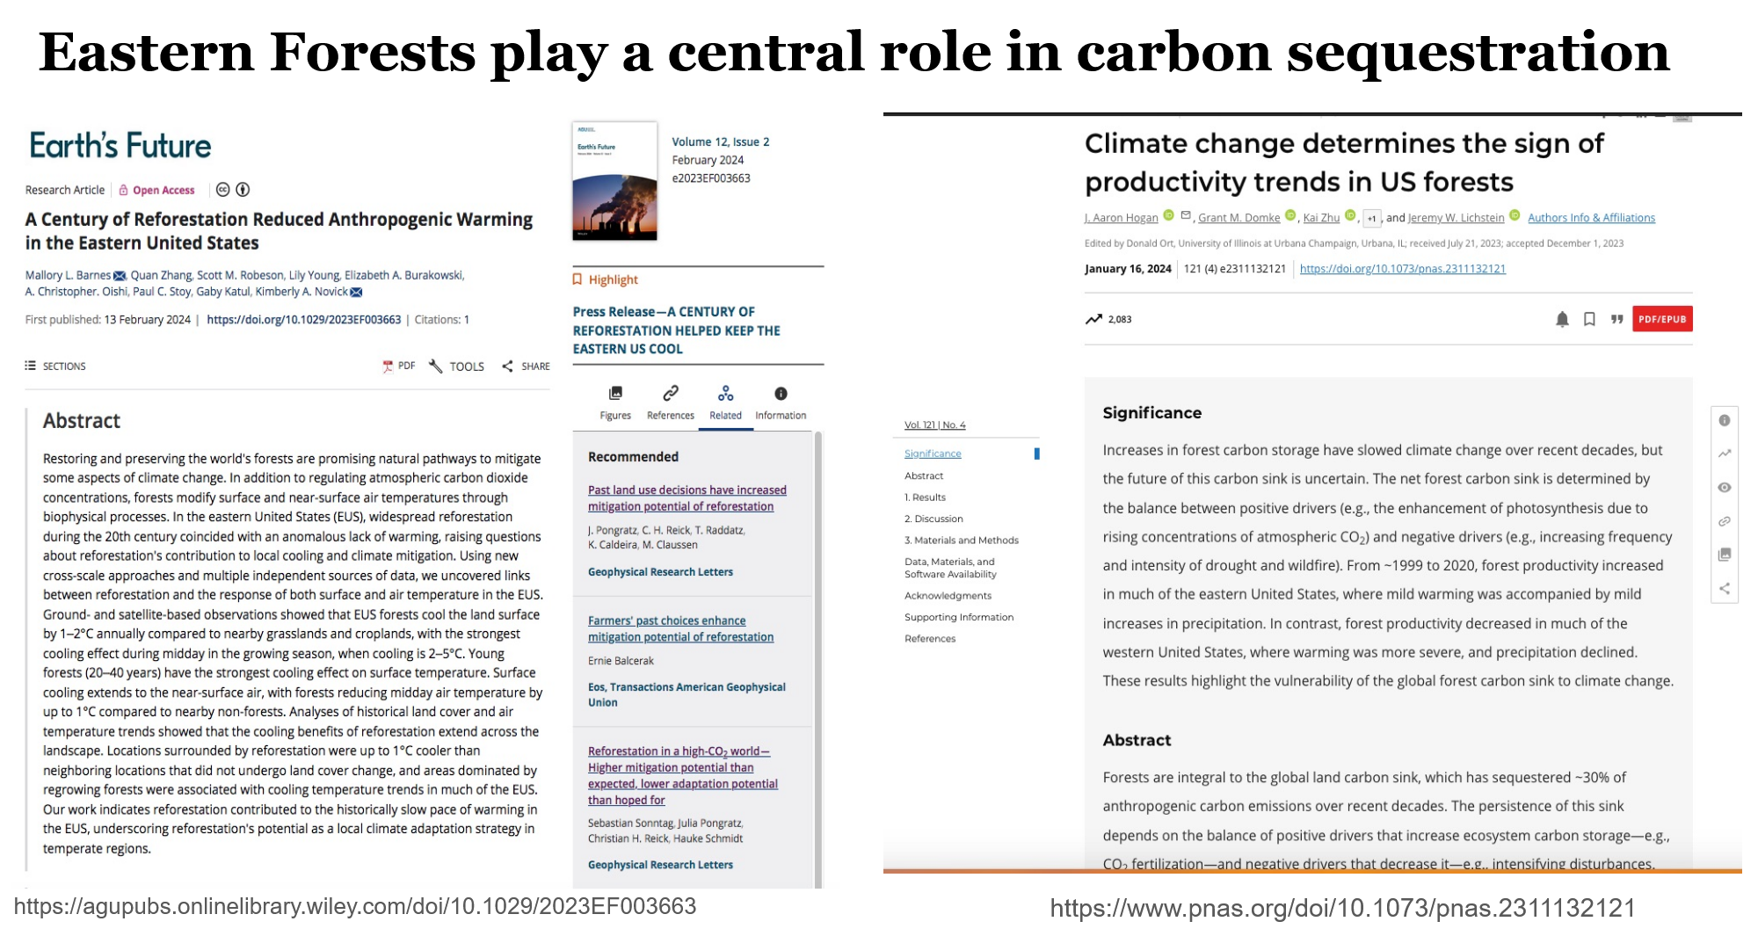
https://agupubs.onlinelibrary.wiley.com/doi/10.1029/2023EF003663

Slide 17
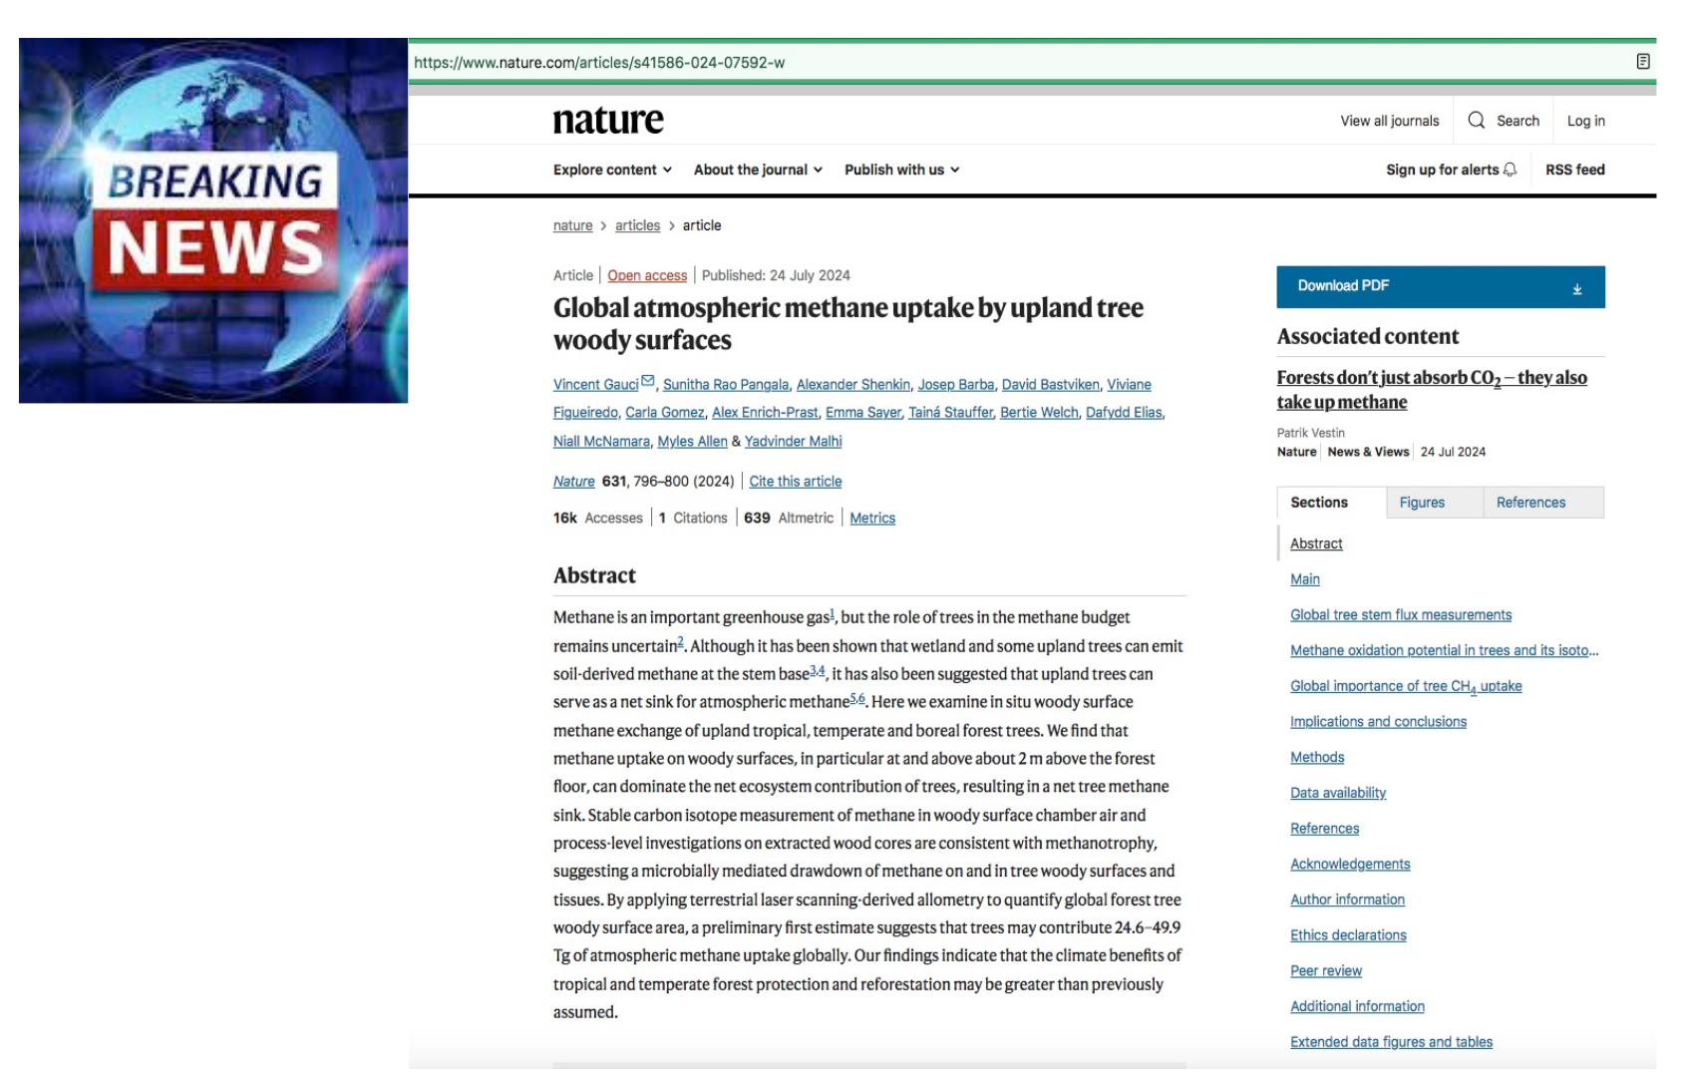
https://www.nature.com/articles/s41586-024-07592-w

Slide 18
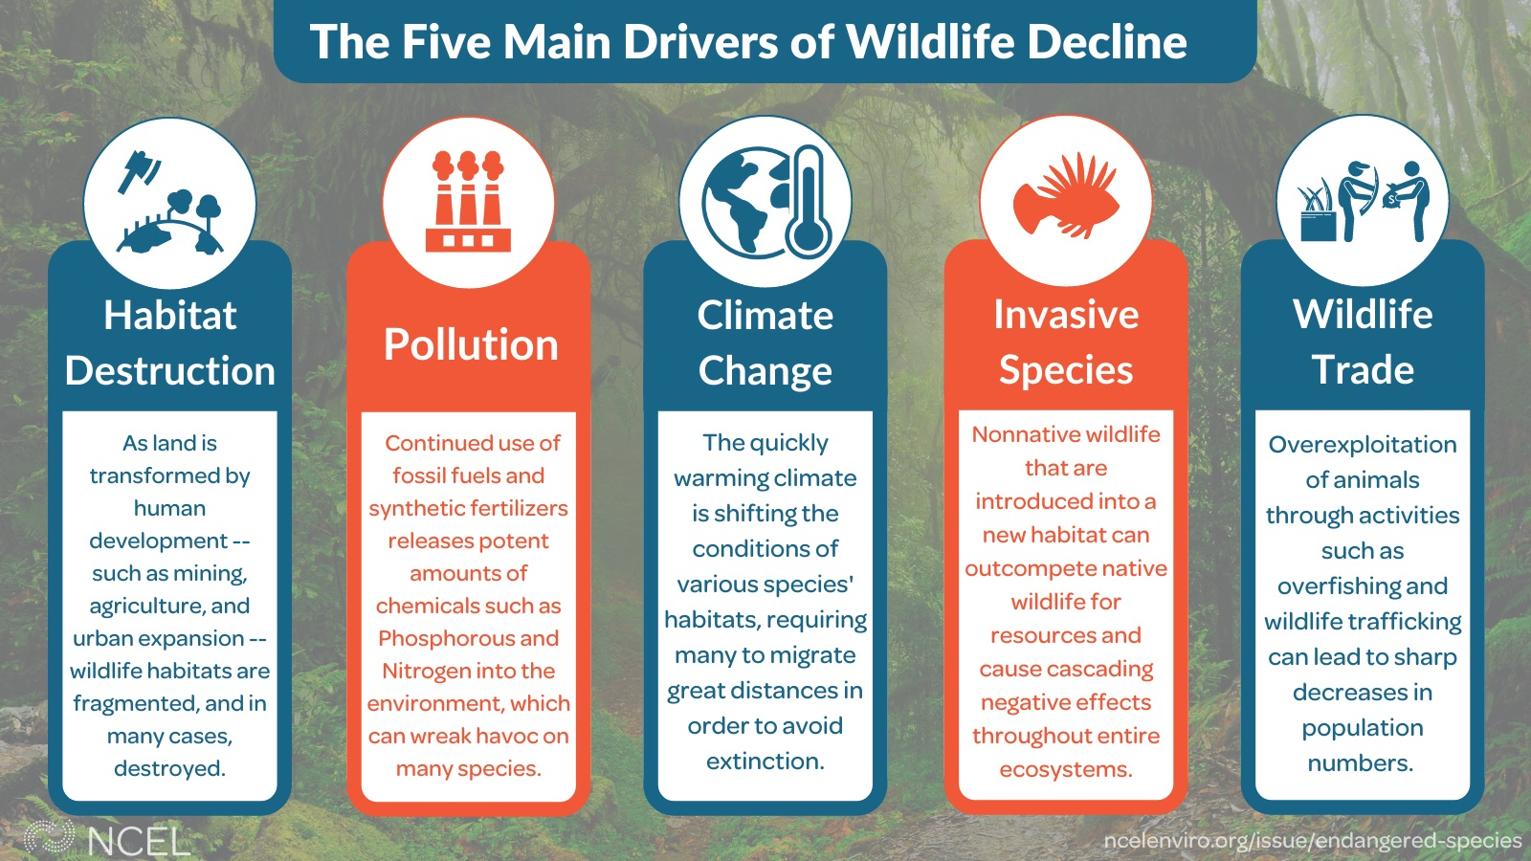

Slide 19
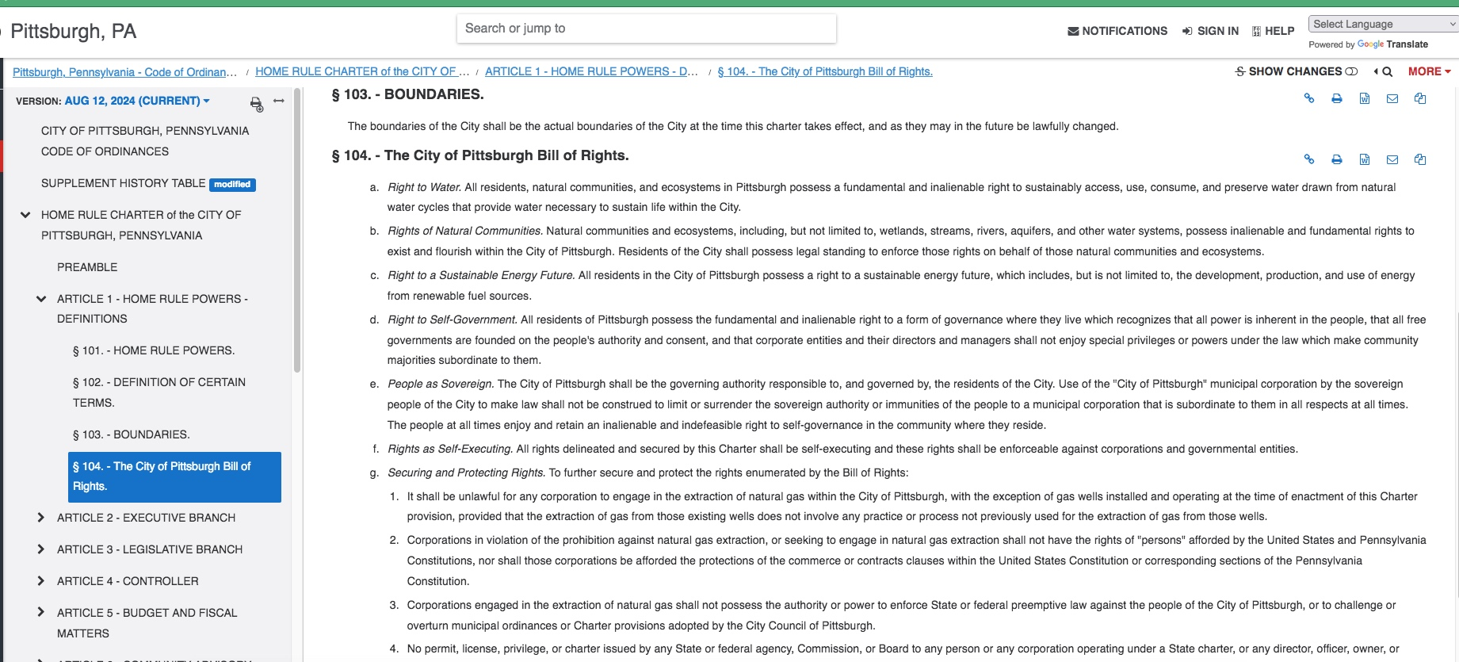
The City of Pittsburgh Bill of Rights
https://library.municode.com/pa/pittsburgh/codes/code_of_ordinances?nodeId=HORUCHPIPE_ART1HORUPOEF_S104THPIBIRI

Slide 20
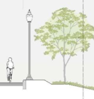
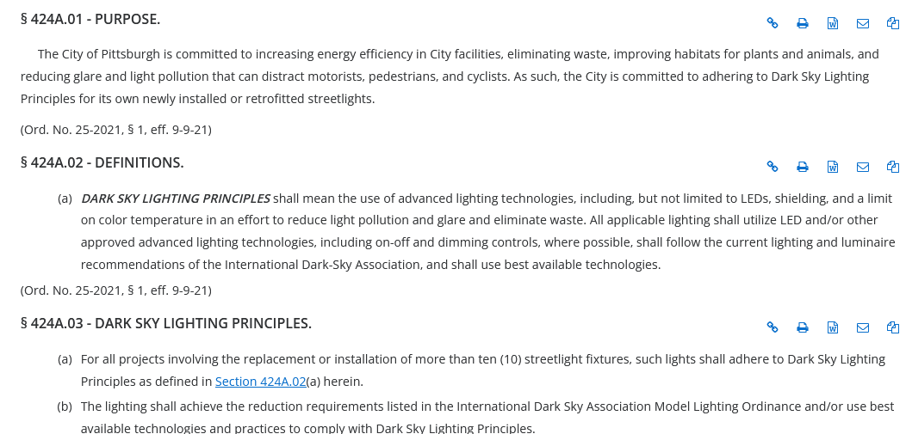
Lighting
DOMI says lighting is Dark Sky compliant
Not trying “new out-of-the-box solutions” like a lighted solar path
https://library.municode.com/pa/pittsburgh/codes/code_of_ordinances?nodeId=COOR_TITFOURPUPLPR_ARTIPURI-W_CH424ADASKLIPRST_S424A.03DASKLIPR
Notes:
yet DOMI refuses to consider anything other than Victorian-era streetlight type options, declaring the absurdity that new technology would be too difficult for Public Works to maintain. This is an insult to the intelligence of city workers in that department, at the very least, and violates the Dark Sky principles. I found this article on their website, refuting the claim that night-lights are important for public safety reasons:

Slide 21
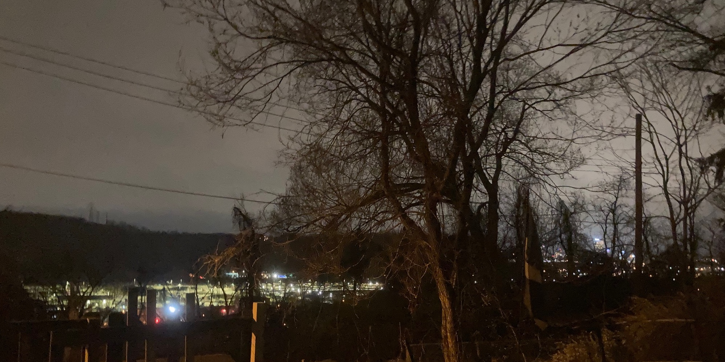
“Communities of color experience over-lighting and light pollution—which can negatively impact mental and physical health—at a disproportionate rate.”
https://www.cmu.edu/mcs/news-events/2021/0922_dark-skies-ordinance.html
Does night lighting harm trees?
https://www.extension.purdue.edu/extmedia/fnr/fnr-faq-17.pdf
Light pollution affects birds:
https://pmc.ncbi.nlm.nih.gov/articles/PMC4375366/
Outdoor lighting at night doesn’t do what you think it does to reduce crime and increase safety
https://darksky.org/resources/what-is-light-pollution/effects/safety/

Slide 22
Budget/Transparency
What is the total itemized budget for this project?
The grant application states the project cost is $2,292,971 and the request is for $1,763,824. Has the city secured funding to cover the difference, and if so, where is it coming from?
Initial grant application and budget
• PennDOT Multimodal Transportation Fund (MTF) 70/30 match
• $2,292,971 for construction
• $1,763,824 in state grant funding (2023 budget)
• $529,147 in local match (2023 budget)
• Planning ~$625 thousand for design (2023 budget)
Is this a reimbursement grant like the 2018 version, and if so where will the initial layout of funds come from?
Reimbursable grant funding
Who will be paying for long-term maintenance of the trail and its shoulder?
“The City of Pittsburgh will be responsible for trail maintenance and clearance for the duration of the life of this infrastructure investment, through its annual operations budget.” (grant application)

Slide 23
Budget/Transparency
The grant application states the project’s total cost is $2,292,971. In 2019, the prior MOC incarnation of this project included $2.7 million just for “retaining wall construction.” Can you explain the difference?
DOMI says, “Current approach uses fewer retaining walls than the conceptual
plan to minimize impact”
Not planning to spend anything beyond grant amount

Slide 24
Budget/Transparency
On what date was the current grant for this project awarded? Will the grant be invalidated if the project is not construction-ready by a certain date?
Building a true community asset takes time
and ground-level community involvement.

Slide 25
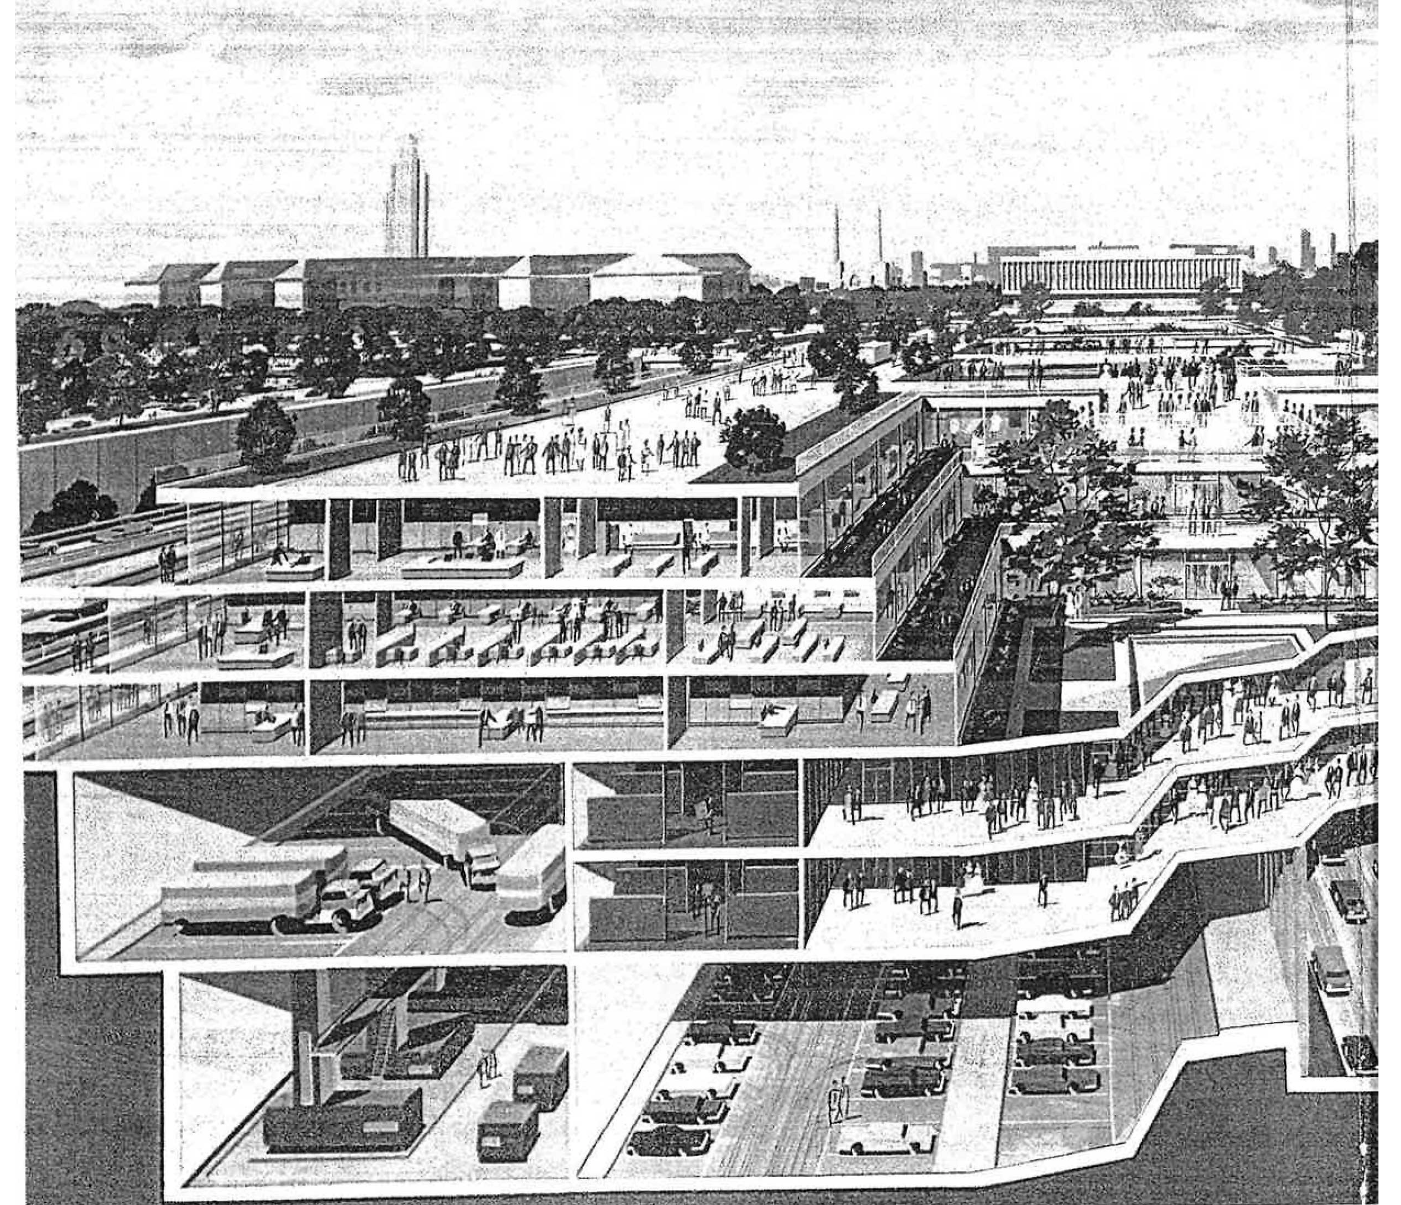
Project scope
(past and present)
“Let’s get an imperfect connector there now and [a] more perfect long-term solution implemented later.”
―Don Smith, RIDC 2019 Mayor’s office meeting

Slide 26
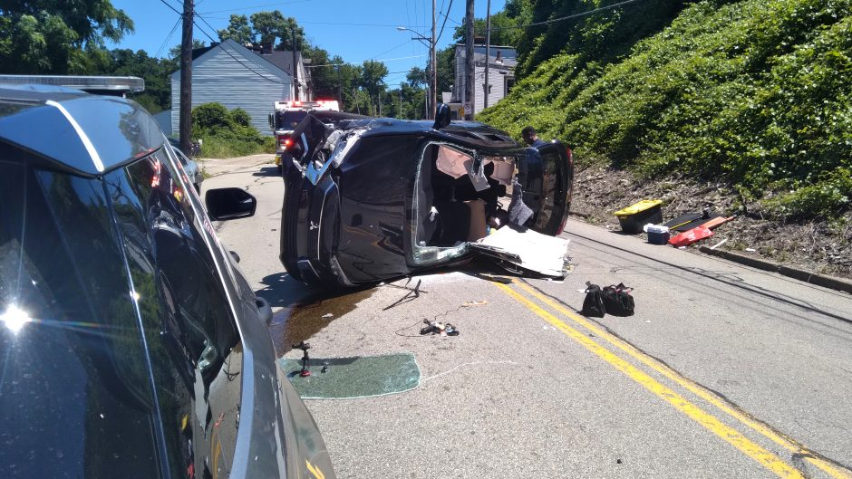
Not in scope
Connections to Bud Hammer Field
Safety of connection to Greenfield Avenue
How can the proposed trail serve as a “low-stress” connection for cyclists and pedestrians when traffic conditions on Greenfield Avenue are notoriously hazardous for both?
Safer crossing under discussion as part of Swinburne Bridge replacement (2026 or later)

Slide 27
Resources
https://agupubs.onlinelibrary.wiley.com/doi/10.1029/2023EF003663
https://www.pnas.org/doi/10.1073/pnas.2311132121
https://www.birmingham.ac.uk/news/2024/trees-reveal-climate-surprise-bark-removes-methane-from-the-atmosphere
https://www.wbur.org/news/2022/02/16/forest-fragments-northeast-us-climate-change-soil-respiration
https://engage.pittsburghpa.gov/stormwater-code
More to come!

Slide 28
Q & A
What is your vision for the
Sylvan Avenue Trail?

Slide 29
Get in touch
junctioncoalition@gmail.com
www.junctioncoalition.org (presentation and resources)

