Slide 1
Community Meeting
Exciting things are coming!
April 9, 2024

Slide 2
Hazelwood Initiative
To Be A Leader in Building A Stronger Hazelwood Through Inclusive Community Development
Affordable Homeownership
Affordable Rentals
Affordable Commercial Space
Neighborhood Investment Fund
Greenspace & Sustainability
Equitable Transportation Access

Slide 4
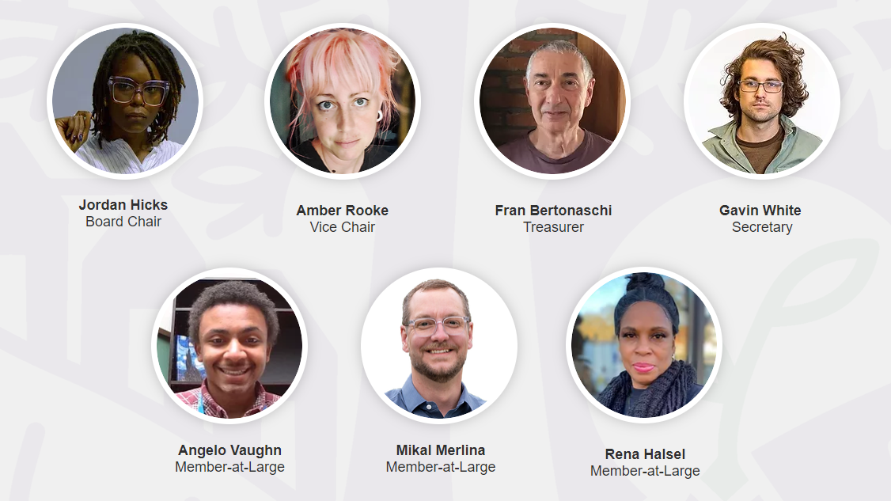
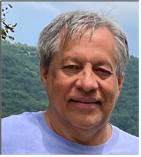
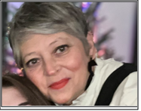
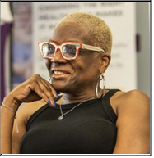
HI Board OF DIRECTORS
Bill Kulina
Kim Wynnyckyj
Terri Shields

Slide 5
Show Your Support By Joining Today! It’s FREE!

Slide 6
Agenda
Learn & Earn
Historic Carnegie Library
Yield Giving Open Call Grant!
Community Announcements
Gift Card Drawing!

Slide 7
Please type your questions in the chat box
Press *6 to unmute and ask questions after each speaker presentation

Slide 8
LEARN & eARN
Caldwell Derrick, Youth Coordinator, Office of the Mayor

Slide 9
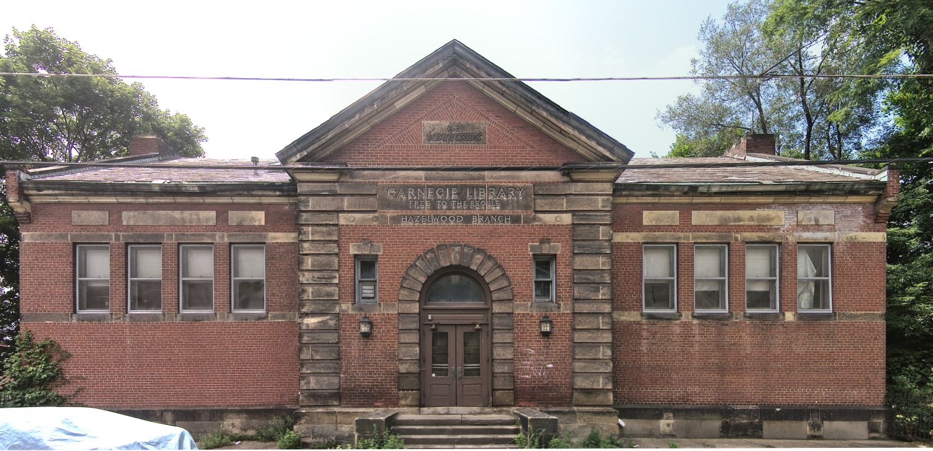
Historic Carnegie Library

Slide 10
YIELD GIVING OPEN CALL GRANT

Slide 11
Background:
Created by billionaire philanthropist Mackenzie Scott
Spring 2023 announced Open Call for applications
Nationwide competition for 250 grants of $1 million ea
6,353 eligible organizations applied
Ultimately made 351 grants, some $1 million & some $2 million

Slide 12
Hazelwood Initiative Strategic PLAN

Slide 13
General announcements

Slide 14
C3 Festival Website Launched TODAY, April 9.
Lineup Announcement: April 16th
Mark your calendars for April 16, as we will be releasing the much-awaited lineup along with an official press release.
Tickets On Sale: April 18th
Tickets for the festival will officially go on sale on April 18. Please note that members of the Hazelwood community will be eligible to receive a free or discounted ticket to the festival based on certain qualifications. Only those who live within Hazelwood and can provide an ID with an address in the neighborhood will be eligible. More details regarding the community ticket program will be shared with your organizations within the next month.

Slide 18
And now, the gift card drawing!
Please let me know in the chat which gift card you’d like: Giant Eagle, Aldi, Target, or Walmart

Slide 19
Thank you!
skanar@hazelwoodinitive.org
jkim@hazelwoodinitiative.org
dbrewton@hazelwoodinitiative.org
ttaulton@hazelwoodinitiative.org
stilghman@hazelwoodinitiative.org
http://hazelwoodinitiative.org
https://www.facebook.com/hazelwoodinitiative/

